Slide 1
DevOps Workshop, Part I

Slide 2
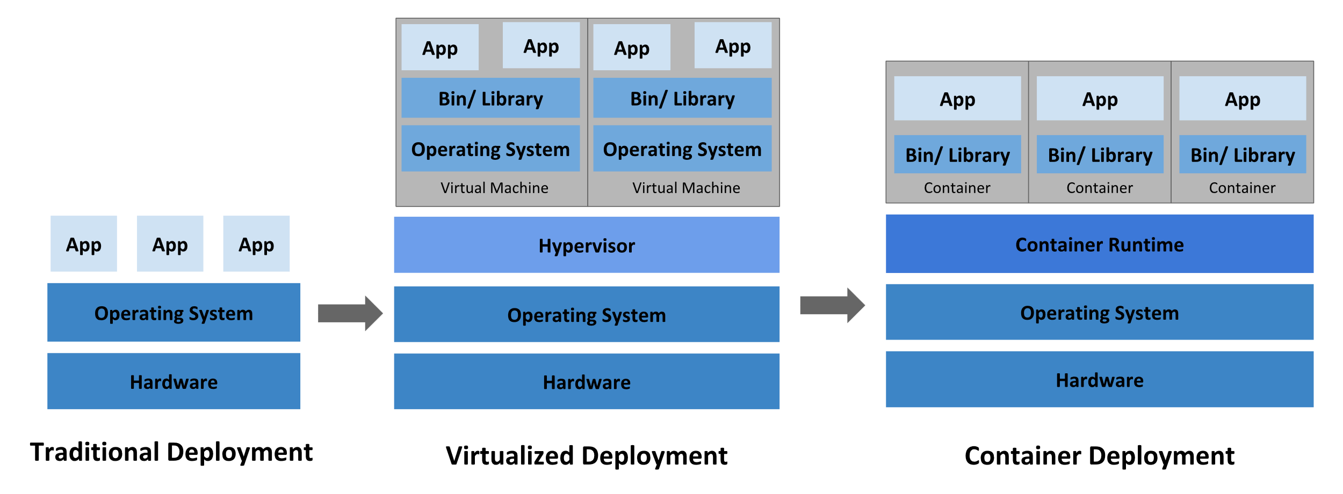
History
2

Slide 3
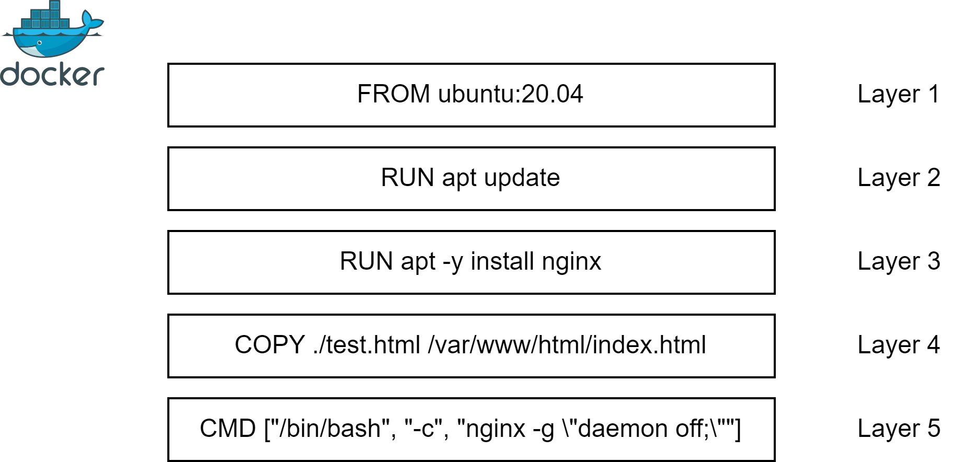
Docker Containers
WHY do we need this?
To simplify deployment process and increase resource utilization.
3

Slide 4


Q&A: story
WHY do we need this?
To see usecases.
It would be great to create world-level online tea-shop!
Well, you need scalable and configurable, platform-agnostic solution, like docker containers.
Alice
Bob
4

Slide 5
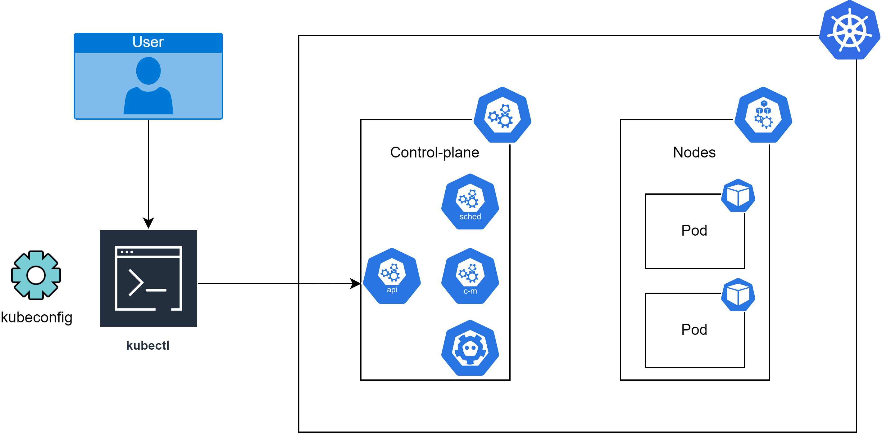
Kubectl
WHY do we need this?
To be able to deploy resources to cluster.
Scheduler - schedules pods
Controller-manager aka
“cluster internal processes manager”
API server aka
“control-plane frontend”
ETCD aka
“cluster distributed backup storage”
5

Slide 6
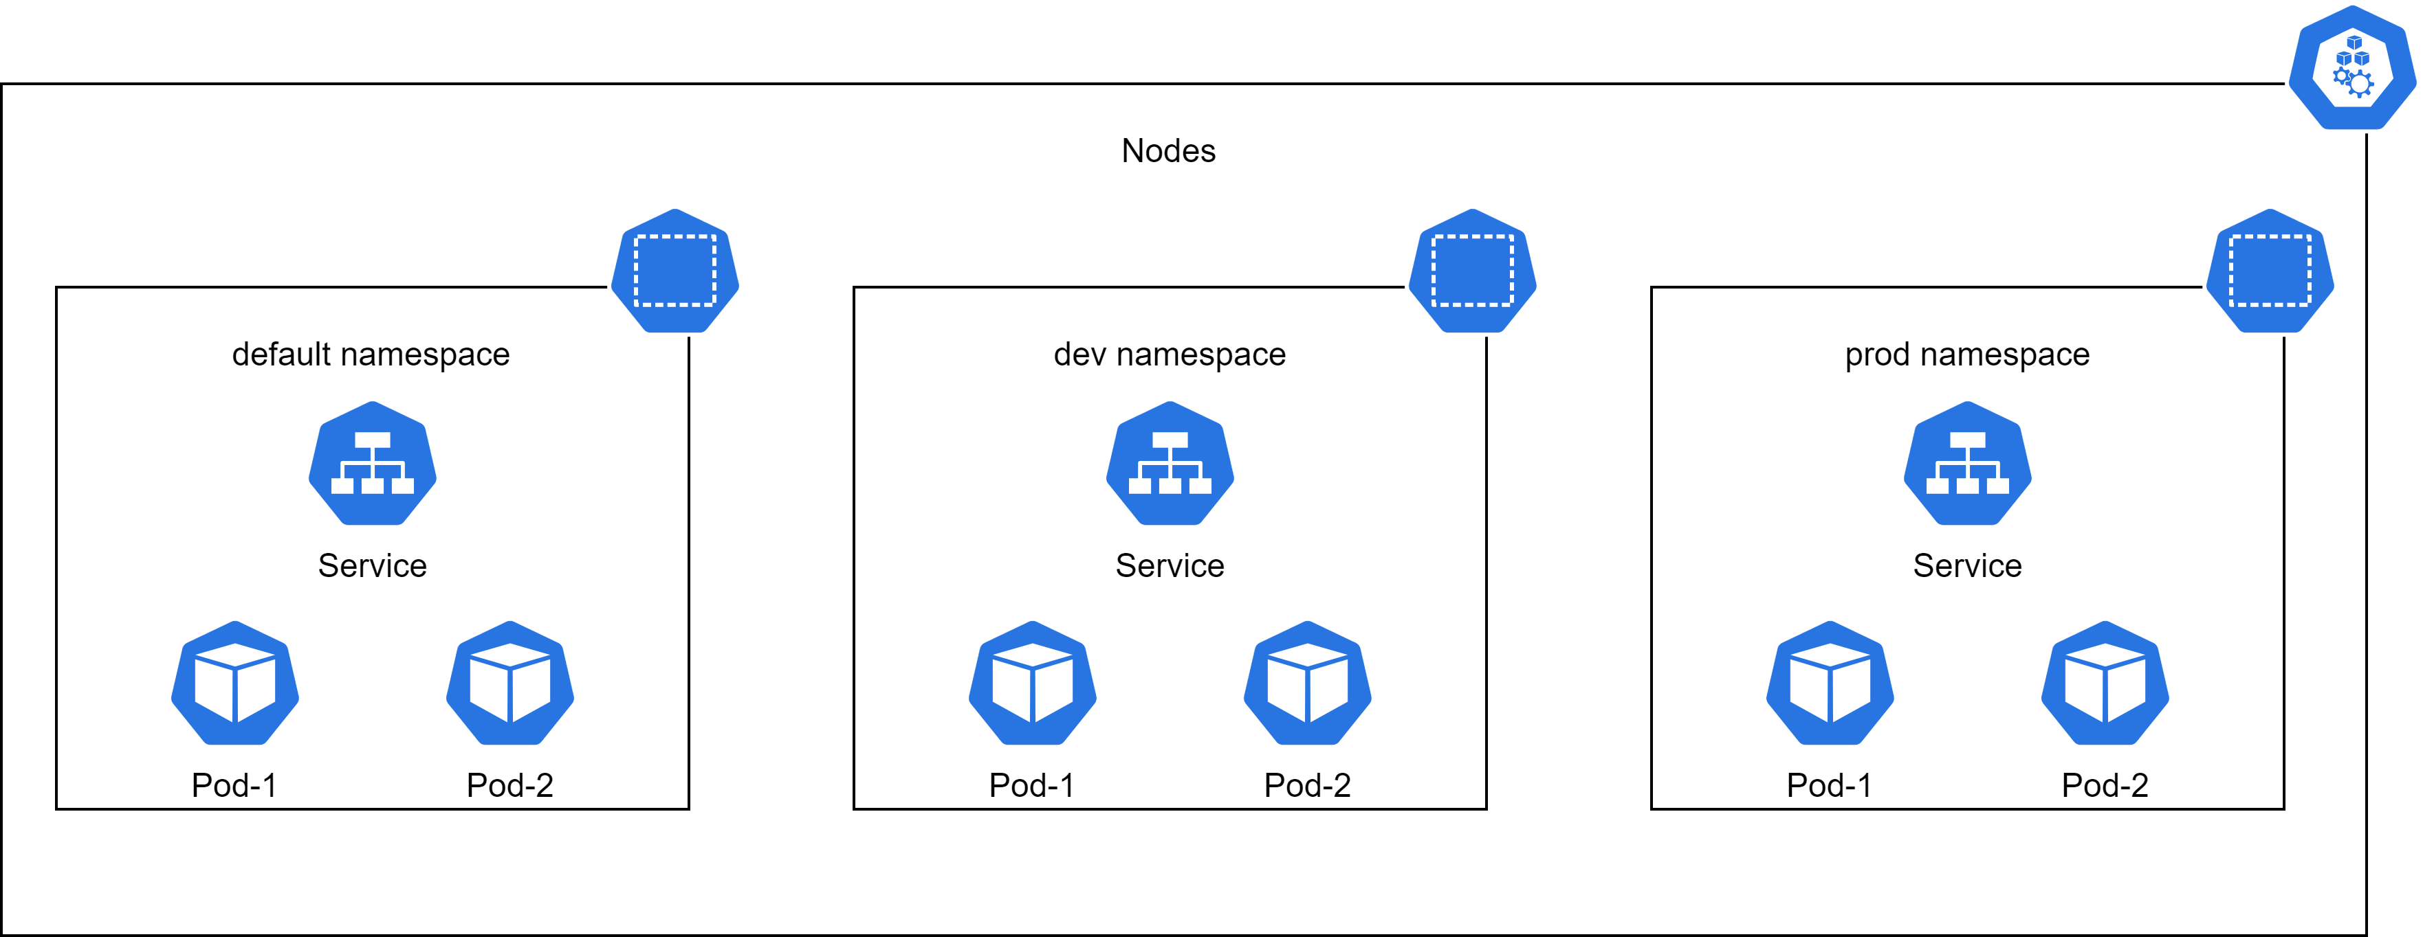
Nodes and Namespaces
WHY do we need this?
Nodes – to run docker containers, Namespaces - to simplify resource management, like folders for files.
6

Slide 7
Q&A: story
WHY do we need this?
To see usecases.
I need deployment, configuration and maintenance automatization for docker containers.
Well, you need container orchestration system like Kubernetes.
Alice
Bob
7

Slide 8
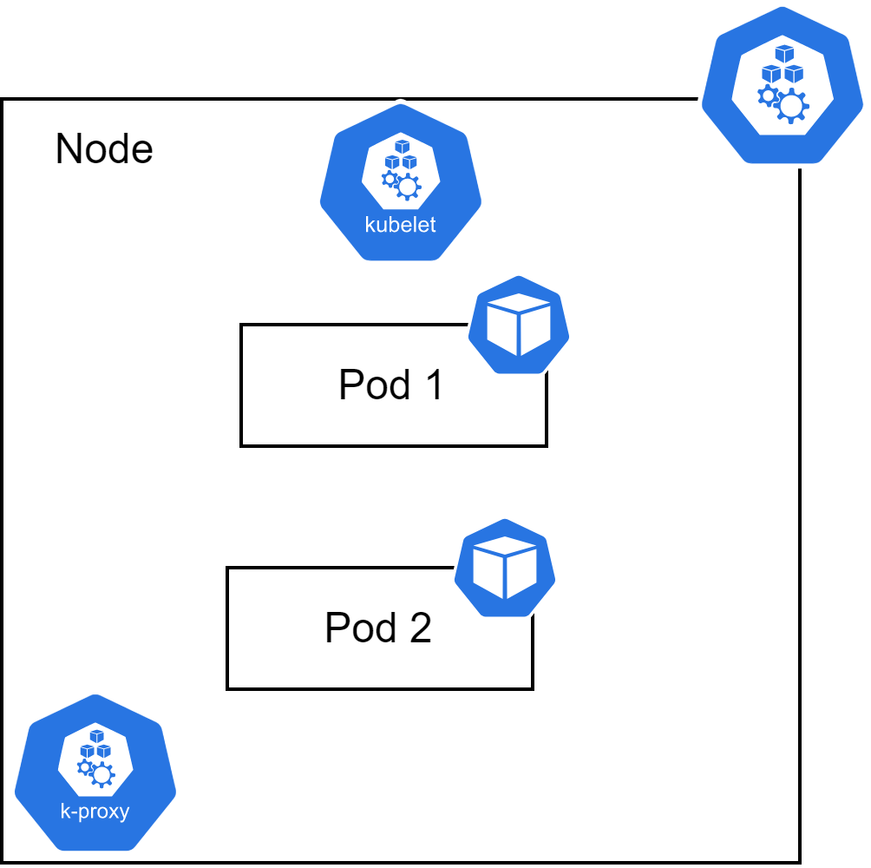
Pods
WHY do we need this?
To configure and run docker container in an efficient way.
8

Slide 9
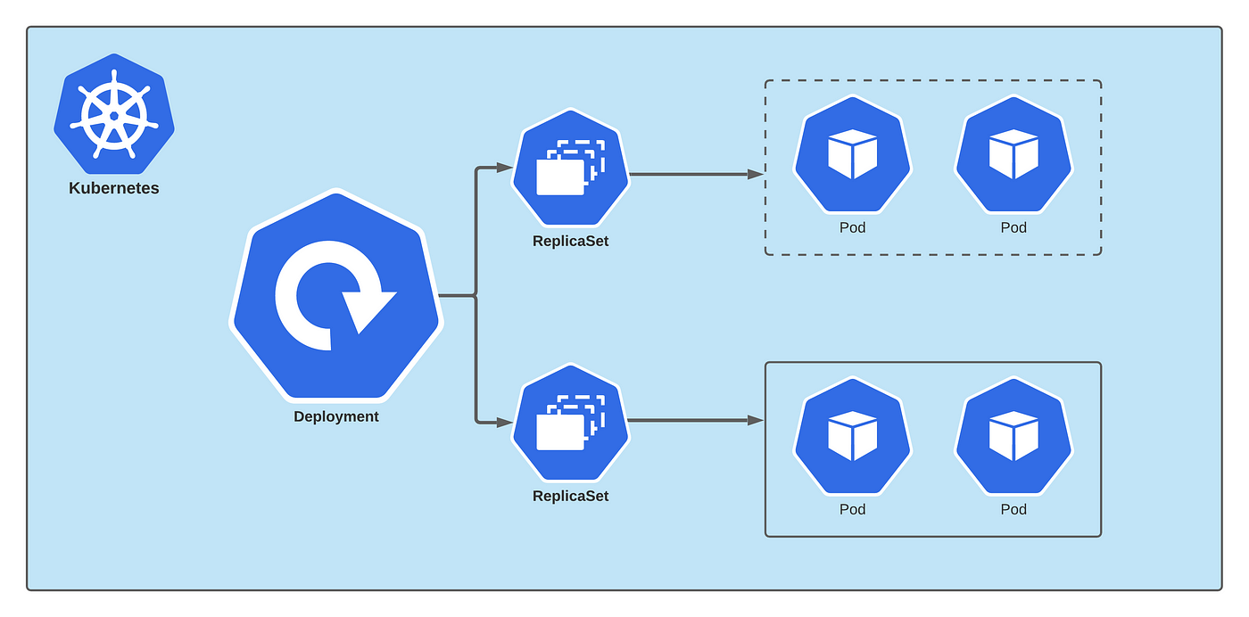
Deployment
WHY do we need this?
To make pods scalable and fault-tolerant.
9

Slide 10
Deployment Affinity
WHY do we need this?
To manage scheduling process for pods.
Affinities
Node
Pod
Affinities
Affinities
Affinity
AntiAffinity
Required
Preferred
10

Slide 11
Q&A: story
WHY do we need this?
To see usecases.
I need to make my online tea-shop frontend scalable and fault-tolerant.
Try using deployment: it is ideal for this.
Alice
Bob
11

Slide 12
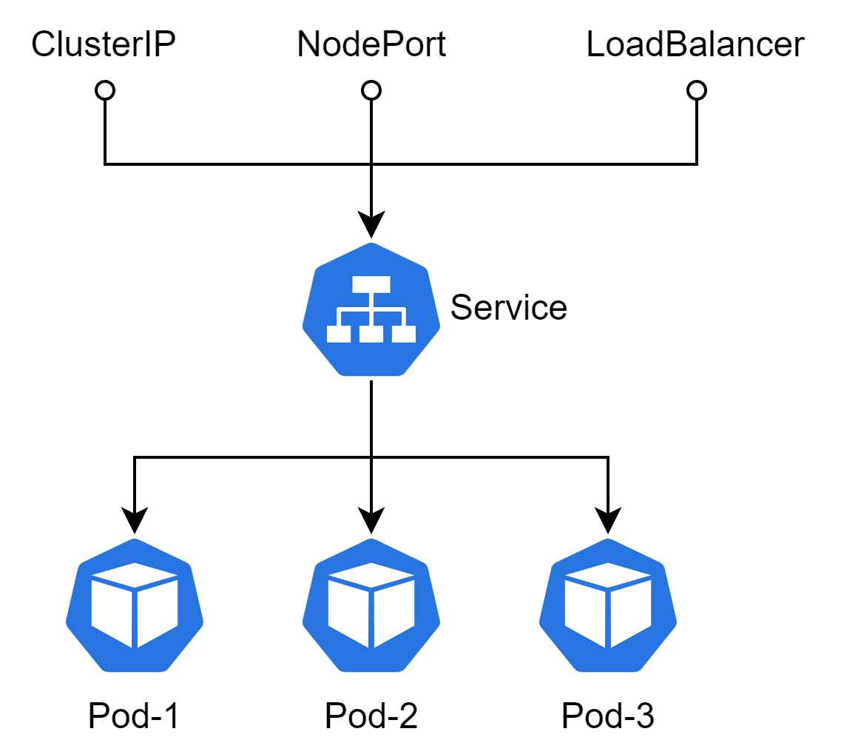
Service
WHY do we need this?
To loadbalance traffic across pods.
12

Slide 13
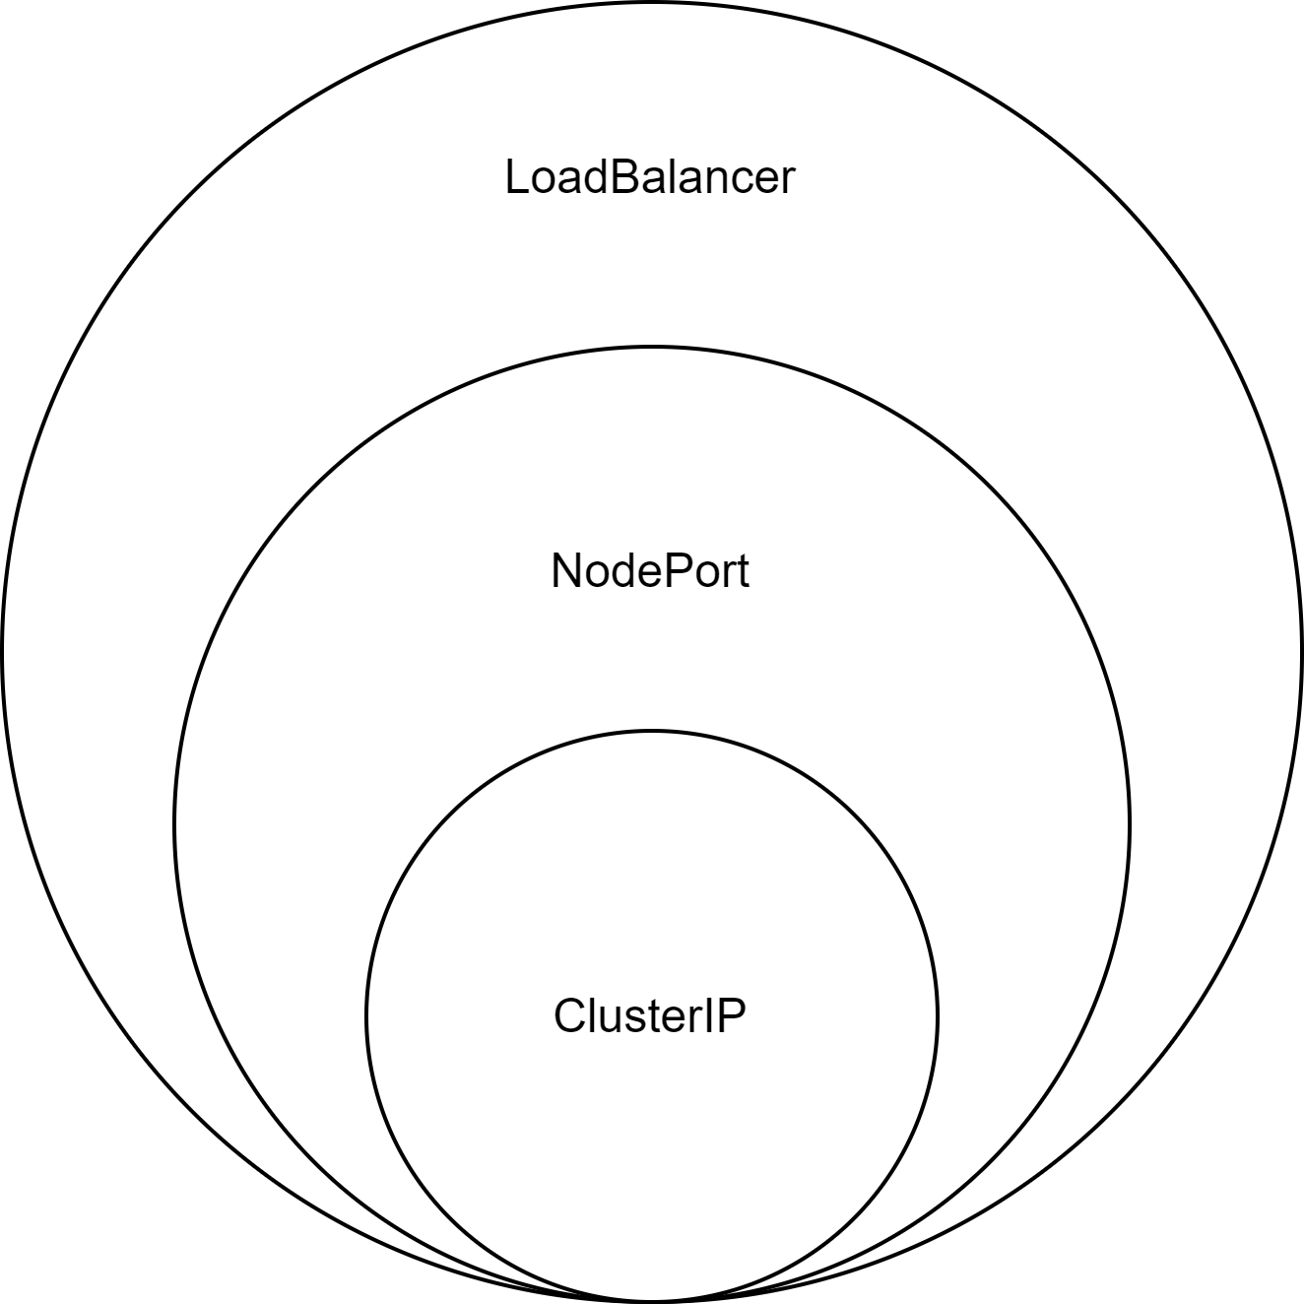
Service exposing
WHY do we need this?
To make service accessible from outside.
13

Slide 14
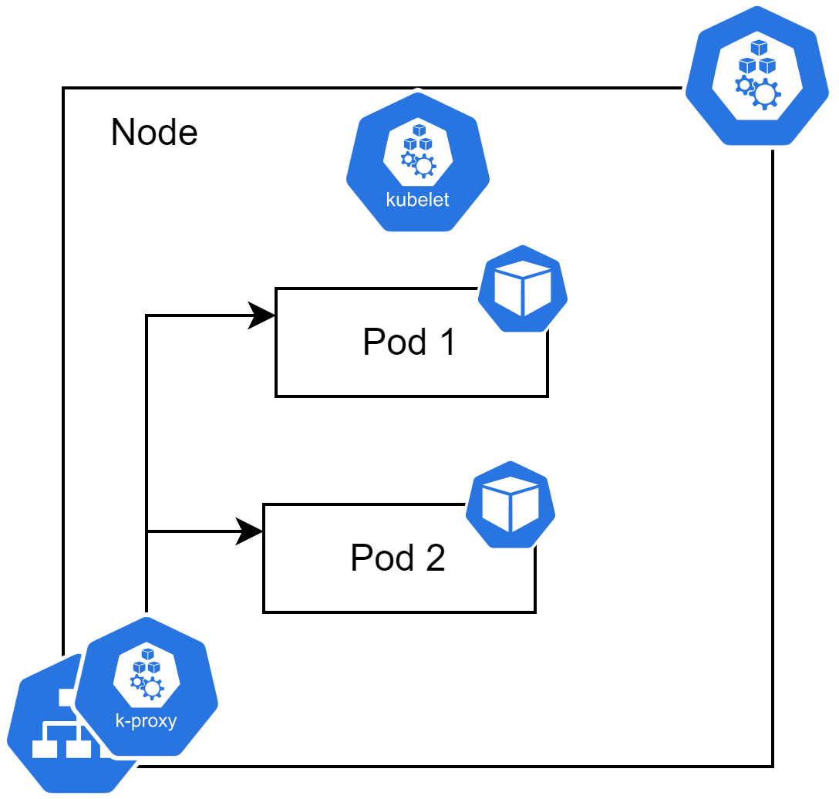
Service high level
WHY do we need this?
To understand how it works in reality.
14

Slide 15
Q&A: story
WHY do we need this?
To see usecases.
But how clients would access all those pods?
Service is the answer! It provides single endpoint for all pods and takes care of loadbalancing task.
Alice
Bob
15

Slide 16
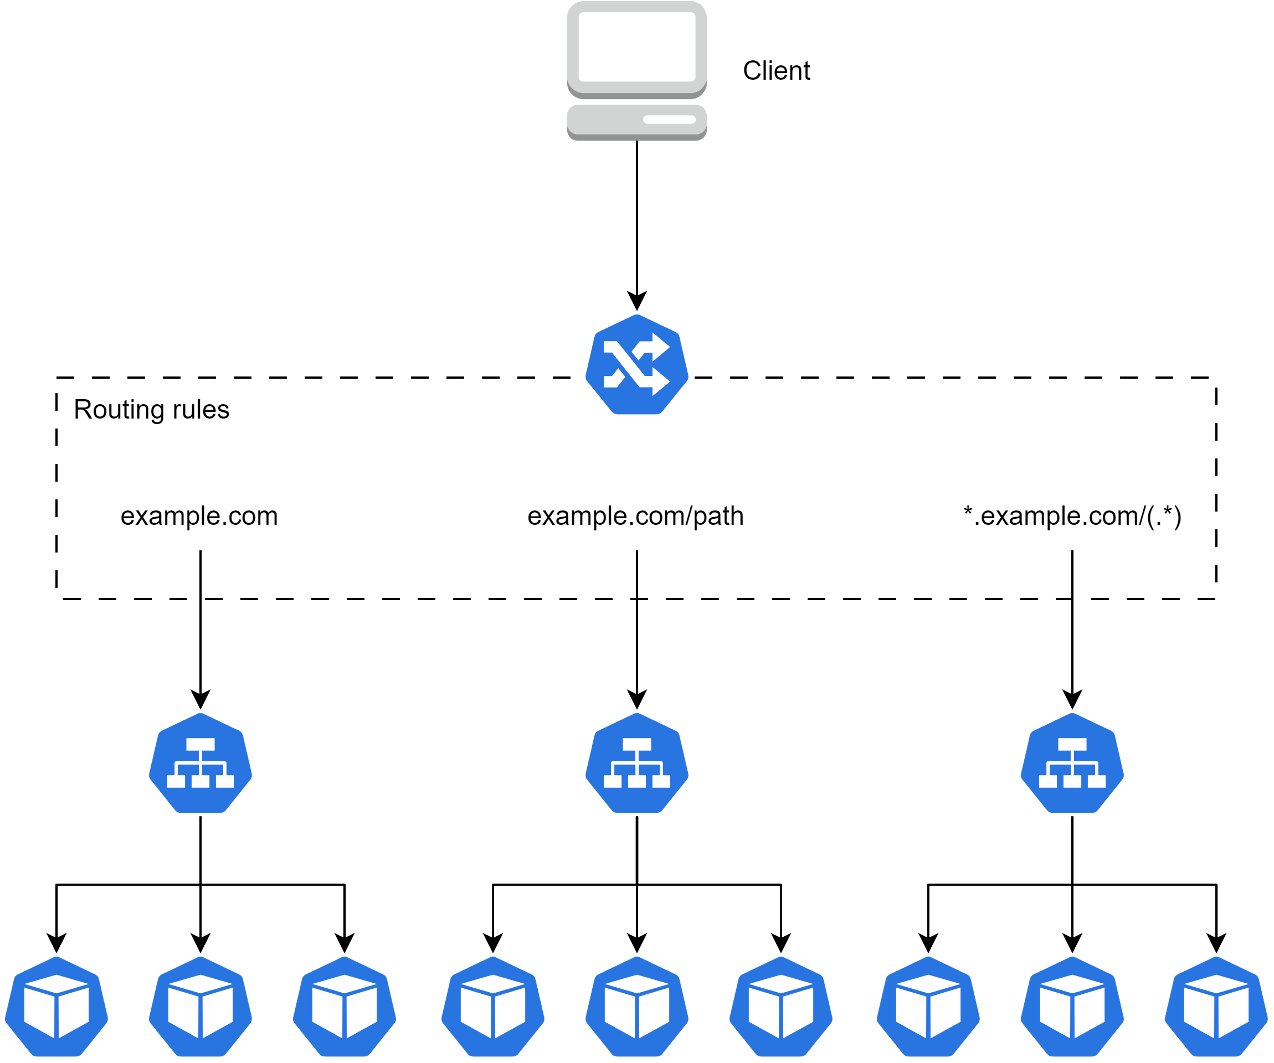
Ingress
WHY do we need this?
To expose service to otter world.
16

Slide 17
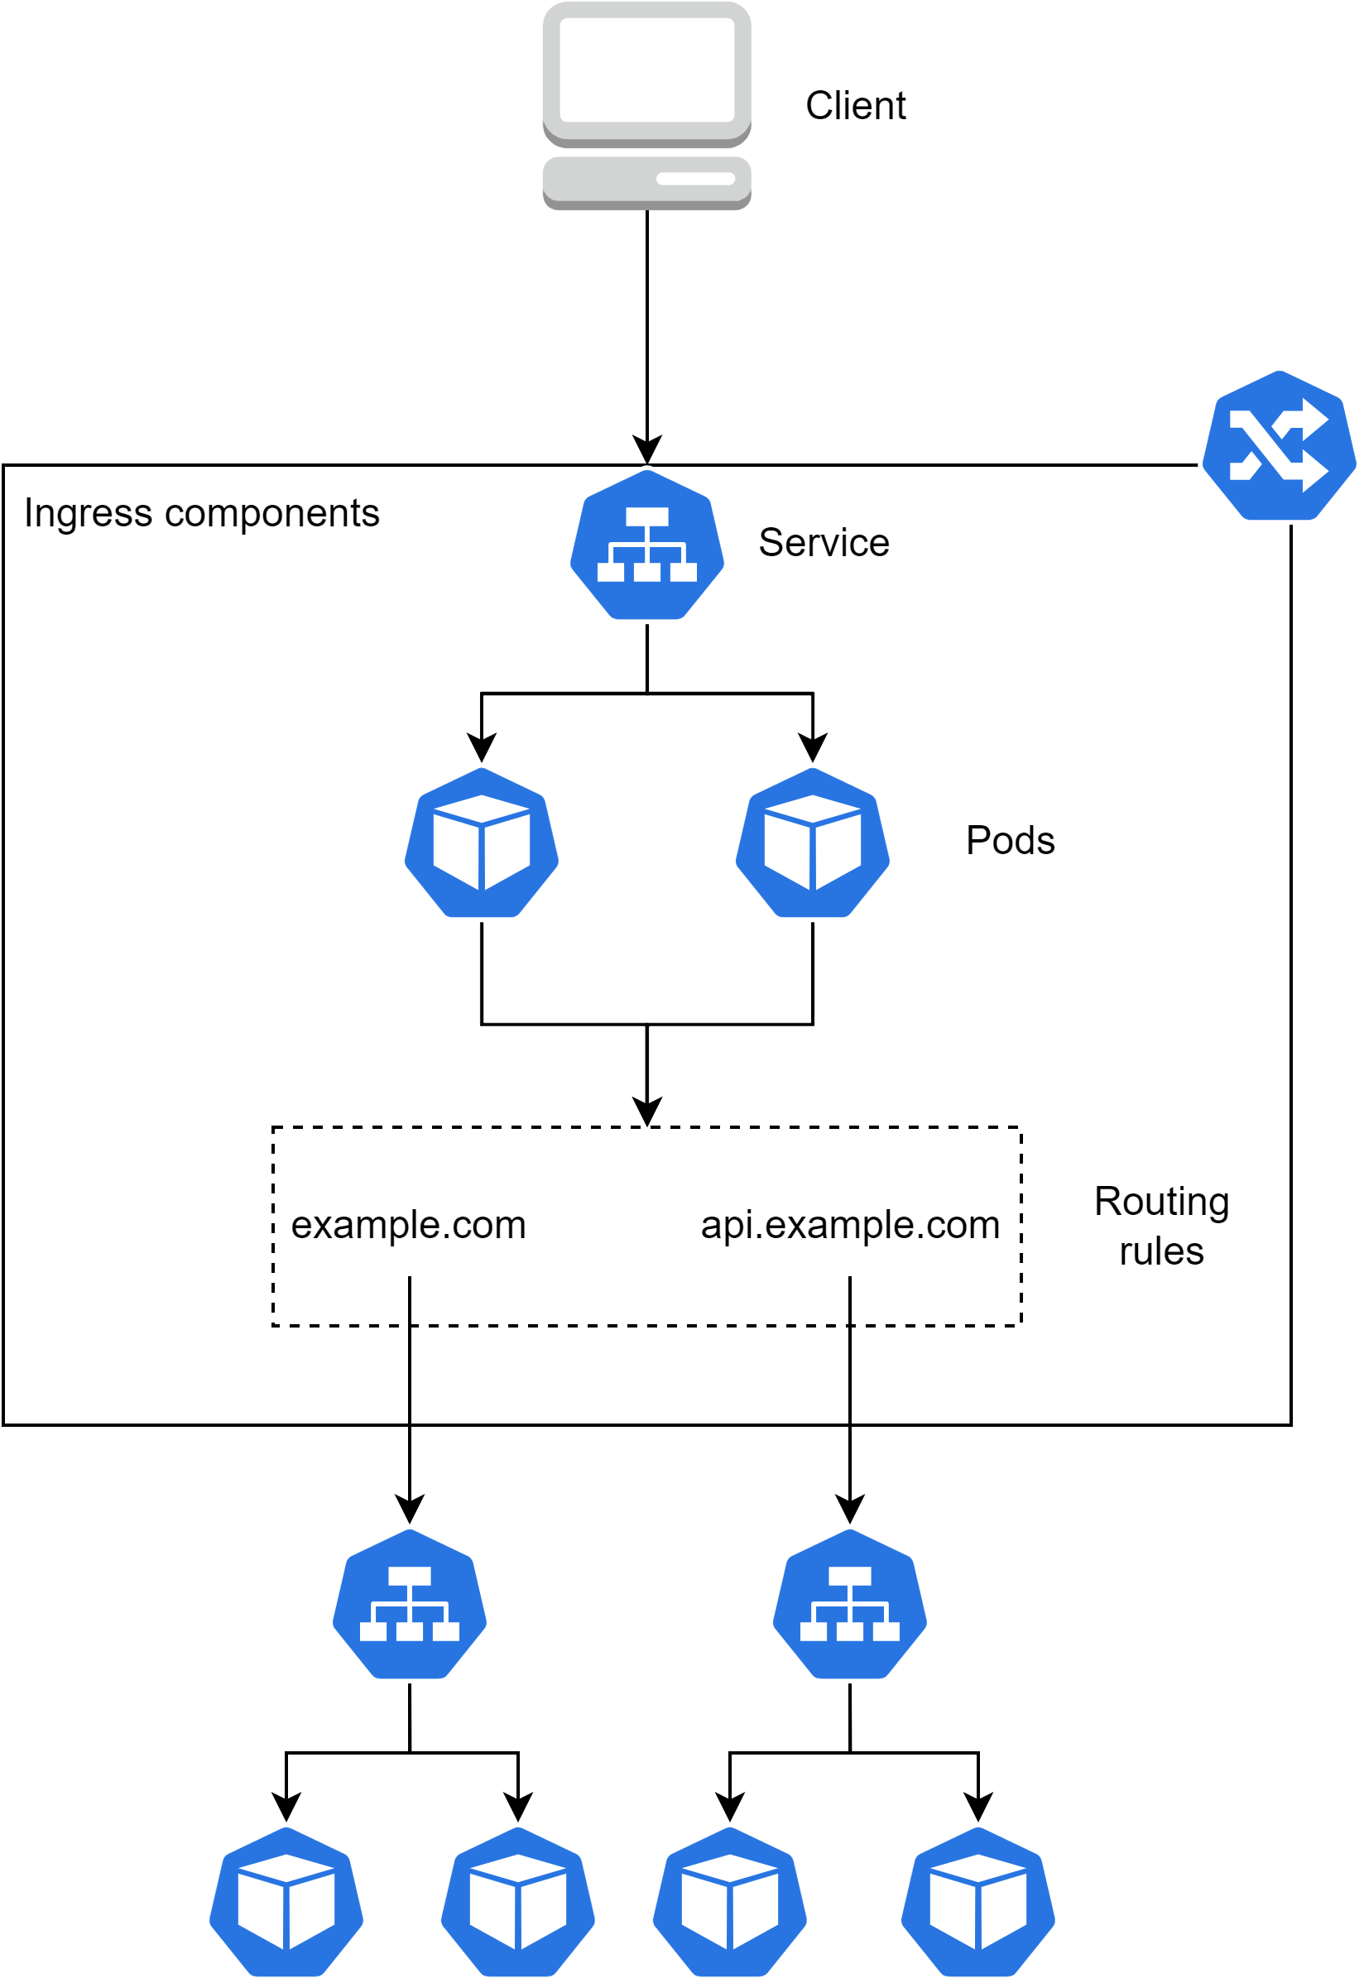
Ingress high level
WHY do we need this?
To understand how it works in reality.
17

Slide 18
Q&A: story
WHY do we need this?
To see usecases.
And what if I have multiple services? How I would make them accessible from otter world?
Ingress would do the job for you.
Alice
Bob
18

